Slide 1
EXCELLENCE IN SERVICES
&
MANUFACTURING
All right reserved. No part of this document may be reproduced.
Stored in a retrieval system or transmitted in any form or by any
means (electronic, mechanical, photocopying, recording or otherwise) without
the permission of the copyright owner.

Slide 2
MISSION & VISION
Company Vision
Excellence in product delivering services to our customer
Company Mission
Provide total solutions for customer
satisfaction

Slide 3
ORGANIZATION CHART
PRODUCTION DEPARTMENT
ADMINISTRATION DEPARTMENT
GENERAL MANAGER
JA’AFAR BIN OTHMAN
SENIOR SUPERVISOR
YUSNAIZI BIN ZAKARIA
MACHINING
FINANCE & ADMIN EXECUTIVE
NURUL FADIDATUL ASMA
CNC
PRODUCT INSPECTION
WELDING
MANUAL
QUALITY CONTROL
QUALITY ASSURANCE
LEADER
LEADER
OPERATOR
OPERATOR
LEADER
LEADER
LEADER
TECHNICIAN
TECHNICIAN
TECHNICIAN
PROCESS ENGINEER
MOHAMAD SHAIFOL BIN MD JALIL
PROJECT COORDINATOR
IDRIS BIN MD YAMIN
PURCHASING & PLANNING PRODUCTION
NURFARHAIN BINTI YAACOB

Slide 4
ORGANIZATION CHART
PRODUCTION DEPARTMENT
ADMINISTRATION DEPARTMENT
GENERAL MANAGER
JA’AFAR BIN OTHMAN
SENIOR SUPERVISOR
YUSNAIZI BIN ZAKARIA
MACHINING
FINANCE & ADMIN EXECUTIVE
NURUL FADIDATUL ASMA
CNC
PRODUCT INSPECTION
WELDING
MANUAL
QUALITY CONTROL
QUALITY ASSURANCE
LEADER
LEADER
OPERATOR
OPERATOR
LEADER
LEADER
LEADER
TECHNICIAN
TECHNICIAN
TECHNICIAN
PROCESS ENGINEER
MOHAMAD SHAIFOL BIN MD JALIL
PROJECT COORDINATOR
IDRIS BIN MD YAMIN
PURCHASING & PLANNING PRODUCTION
NURFARHAIN BINTI YAACOB

Slide 5
GENERAL INFORMATION
CAPABILITIES
We are capable of doing micron jobs ranging from tool steel to tungsten carbide material. For semi precision parts such as machine parts or jig & fixture for assembly purposes which use more non-metallic material such as PVC,ULTEM,DELRIN, TEFLON and many more
Our current manpower at working place are 24 persons
OBJECTIVE
Our objective are to ensure quality, durability and follow customer requirement. We are responding to the industries call for higher productivity with lower cost and customer satisfaction is our philosophy.

Slide 6
DETAILED OBJECTIVES
Sales & Marketing
To achieve at least 80% of the customer satisfaction survey results.
However, to achieve 100% of the customer satisfaction for power plant and oil and gas product
To achieve less than 2 cases of customer complain per month.
QA/QC
For critical Parts : To achieve less than 25% of rejection rate.
For non-critical parts : To achieve less than 5% of rejection rate.
For power plant and oil and gas product : 0% rejection rate
Finance & Admin
To achieve at least 75% of average rating for annual suppliers evaluation results.
Machining
To achieve at least 90% of machine utilization.
To achieve less than 10% of production rejection.

Slide 7
POLICIES
We are involved in technical designing and manufacturing of precision engineering parts for power plant, automotive, electronics and dental parts. Thus, it is our commitment to achieve customer’s satisfaction with quality products and excellent services.
It is our commitment to comply with ISO 9001:2008 and statutory and regulatory requirements and continually improve its effectiveness.
We shall establish quality objectives at relevant functions in the company.
The quality policy and quality objectives shall be reviewed periodically for continuing
suitability.

Slide 8
COMPANY DATA
Company Name | Micro Precision Machining Sdn Bhd
Company No | 691735-V
Establishment | 16th May 2005
Business Address | No.2, Jalan Mega A, Taman Industri Mega, 43500 Semenyih, Selangor Darul Ehsan
Tel | 03-87278803
Fax | 03-87278839
Website | www.mpmsb.com.my
E-mail | jaafar@mpmsb.com.my
Bank Account | 100810015305 AFFIN BANK SERI KEMBANGAN
Capital | RM 500,000.00
Director | Ja’afar bin Othman
Employee | 24 persons (Year 2016)

Slide 9
COMPANY BUSINESS
Mold tool
& die
CNC auto lathe
(mass production)
SERVICES
PROVIDED
INVOLVES
Fabrication
Turning Part
Jig & Fixture

Slide 10
FIELD OF BUSINESS
Technical designing and manufacturing of precision engineering parts for power plant, automotive, electronics and Dental parts.
From our past experience, we shall be capable of producing oil and gas parts
Power plant parts fixing, site machines modification, service and repair.
We have done retrofit of machine and modification for CNC Milling, CNC Lathe, Rauters and Wire Cut Machine.
We provide training to college and universities for lecturers and students regarding operating and maintenance of machines

Slide 11
MAIN CUSTOMERS
PRIVATE
TNB REPAIR & MAINTAINANCE SDN.BHD,
TNB RESEARCH SDN BHD
OHTA PRECISION (M) SDN BHD
DAIJIN TECH SDN BHD
AMT ELECTRONICS SDN BHD
ALUM MAJU SDN BHD
J FOONG TECHNOLOGIES SDN BHD
INDKOM ENGINEERING SDN.BHD
GULF INDUSTRIES SDN. BHD
TENAGA SWITCHGEAR (M) SDN. BHD
MICROMECHANICS SDN BHD
ZHOU SPECIALIST DENTAL SURGERY
SAPURA THALES ELECTRONIC SDN BHD

Slide 12
MAIN CUSTOMERS
GOVERNMENT
MARDI
.
KOLEJ KOMUNITI
MICROMECHANICS SDN BHD
KOLEJ KEMAHIRAN TINGGI MARA
POLYTECHNIC
UNIVERSITES

Slide 13
FLOW CHART
FEEDBACK TO
SUPPLIER
NG
INCOMING
MATERIAL
NG
QC INSPECTION
OK
PRODUCTION SETTING
TECHNICIAN
NG
QC INSPECTION
FIRST
INSPECTION DATA
OK
MASS
PRODUCTION
QC CONFIRMATION
SORTING & REWORK
NG
FINAL INSPECTION
QA CONFIRMATION
OK
PACKING
DELIVERY (DO) (INV)

Slide 14
QUALITY CONTROL FLOW CHART
QUALITY FLOW CHART
SETTING
(PRODUCTION PART
(TECNICIAN)
PACKING
(STANDARD)
OK
NG
FIRST INSPECTION
QA(5PCS)
OK
NG
FINAL
INSPECTION
MASS
PRODUCTION
QC/QA
CONFIRMATION
DAILY INSPECTION
QA/QC (5PCS)
SCREENING
DAY
SHIFT
NIGHT SHIFT
OK
QC CONFIRMATION
NG
SORTING &
REWORK
NG
OK
FEEDBACK TO
PRODUCTION

Slide 15
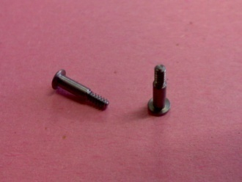
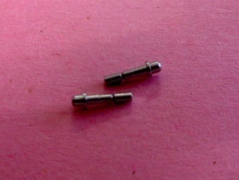
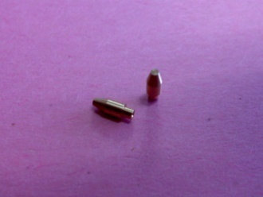
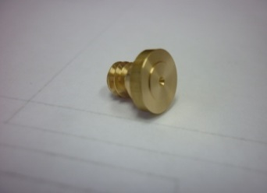
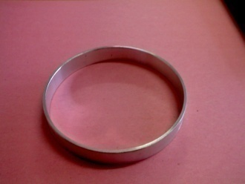
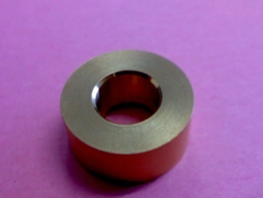
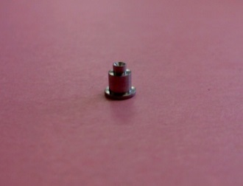
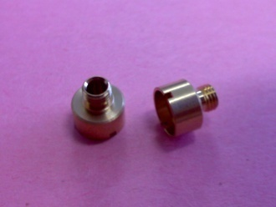
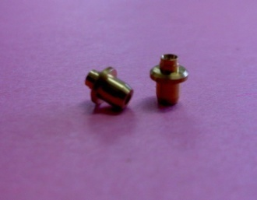
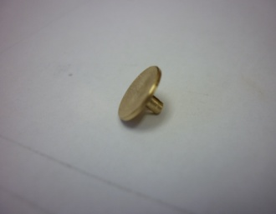
SERVICES/PRODUCTS RANGE
Our highly skill engineers and technicians hands on to fulfill our customers satisfaction. We are committed to our business principal/motto “Excellence In Services & Manufacture“ so that we will provide better services and product quality to our customer. We can produce engineering parts for medical , power station , Oil & Gas electronics , automotive, and etc.

Slide 16
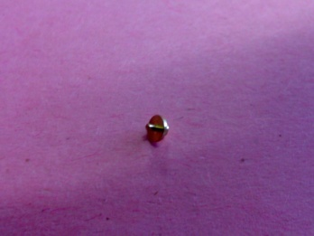
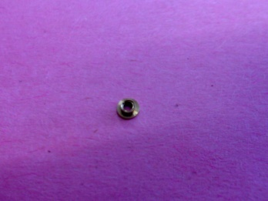
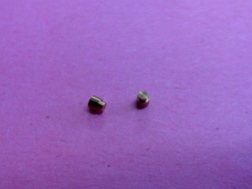
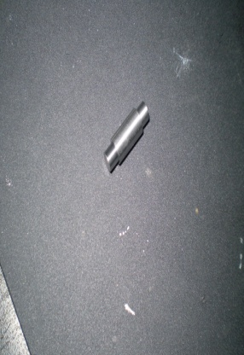
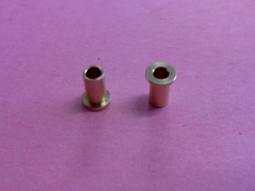
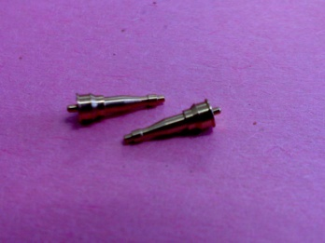
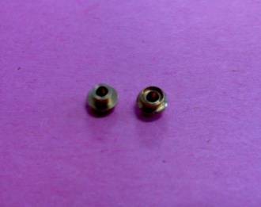
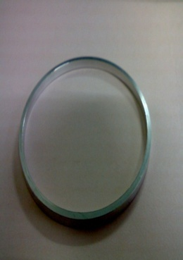
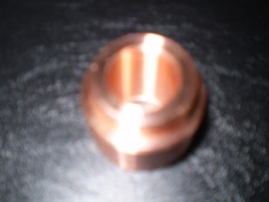
PICTURES FROM OUR PRODUCTS

Slide 17
LIST OF MACHINES
List of Machine in Kajang
Maker/type | Description | Quantity
FUKU SENKI | CNC LATHE MACHINES | 1
KITAMURA | CNC LATHE MACHINES | 3
CINCOM CITIZEN R04 | CNC AUTO LATHE | 2
CINCOM CITIZEN L10 | CNC AUTO LATHE | 1
TSUGAMI B018 | CNC AUTO LATHE | 2
TSUGAMI B020 | CNC AUTO LATHE | 5
NOMURA | CAM AUTO LATHE | 15

Slide 18
LIST OF MACHINES
List of Machine in Penang
Maker/type | Description | Quantity
SODICK AM3L | EDM MACHINE | 3
DMG DMU50 | DMG CNC MILING MACHINE | 6
CTX 310 GLIDEMEISTER | CNC LATHE MACHINE | 3
FUNUC | WIRE CUT FUNUC MACHINE | 3
OKAMOTO | SURFACE GRINDING MACHINE | 3

Slide 19
PICTURES OF MACHINE

Slide 20
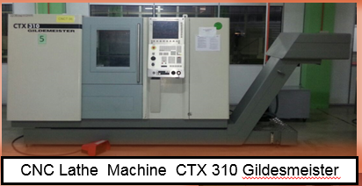
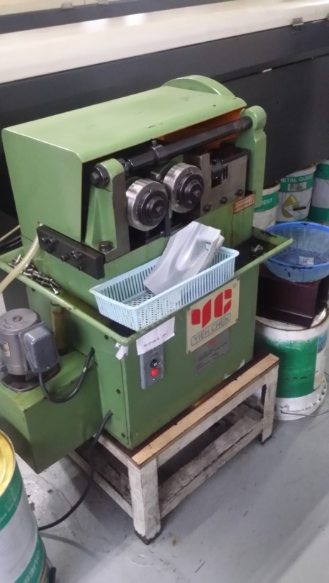
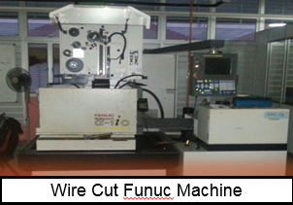
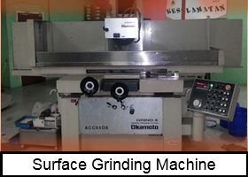
PICTURES OF MACHINE
Rolling Thread Machine

Slide 21
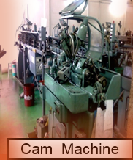
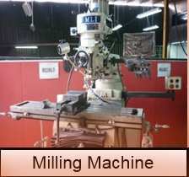
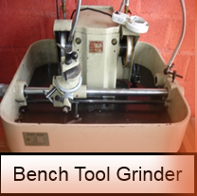
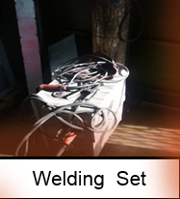
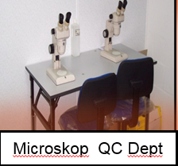
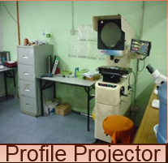
PICTURES OF EQUIPMENT

Slide 22
LIST OF OTHER MACHINERIES
GRINDING MACHINE
MACHINE NAMES | QUANTITY | YEAR OF MANUFACTURED | MADE IN
OKAMOTO-450DX | 2 | 2001&2001 | JAPAN
OKAMOTO-52ST | 1 | 2000 | JAPAN
WIRE CUT MACHINE
MACHINE NAMES | QUANTITY | SIZE | ACCURACY | MADE IN
FANUC-ALPHAR-1IC | 1 | 520X370X310 | +/- 0.003 | SWITZERLAND

Slide 23
LIST OF OTHER MACHINERIES
EDM MACHINE
MACHINE NAMES | QUANTITY | SIZE | MADE IN
FINE SODICK-MOLD MAKER 3 | 1 | 300X200X200 | JAPAN
SUPER DRILL MACHINE
MACHINE NAMES | QUANTITY | MADE IN
CASTEX-MD2D | 1 | TAIWAN

Slide 24
QC EQUIPMENT
PROFILE PROJECTOR
MACHINE NAMES | QUANTITY | MADE IN
DELTRONIC-216 | 2 | USA & JAPAN
DIGITAL HEIGHT GAUGE
MACHINE NAMES | QUANTITY | MADE IN
TRIMOS-V300++ | 4 | SWITZERLAND

Slide 25
LIST OF OTHER MACHINERIES
MICROSCOPE
MACHINE NAMES | QUANTITY | MAX ZOOM | MADE IN
OLYMPUS/NIKON | 8 | 200x | JAPAN
STANDARD NORMAL CHECKING EQUIPMENTS
MACHINE NAMES | QUANTITY | BRAND
CALIPER | 6 | TESA& MITUTOYO
BLOCK GAUGE | 2 SETS | GRADE 0
DIGITAL MICROMETER | 10 | MITUTOYO
DIGITAL GAUGE | 3 | SYLVAC
DIAL TEST INDICATOR | 5 | TESA

Slide 26
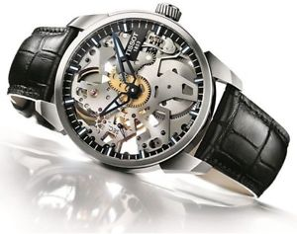
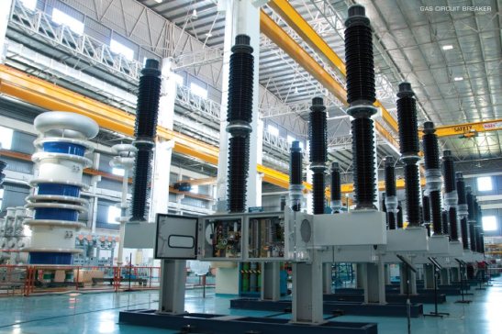
LIST OF EXPERIENCE
MICROMECHANICS SDN BHD
Able to maintain/control tolerances up to 10 microns
SWITCH GEAR PRODUCT

Slide 27
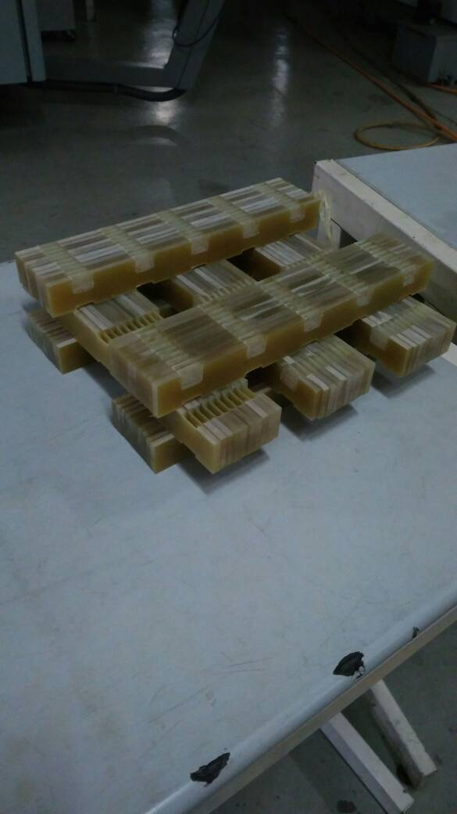
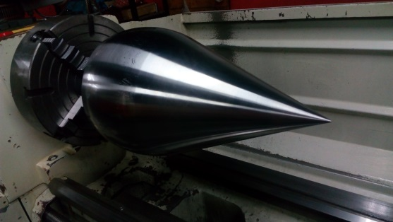
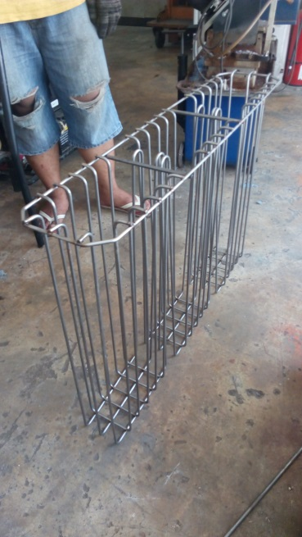
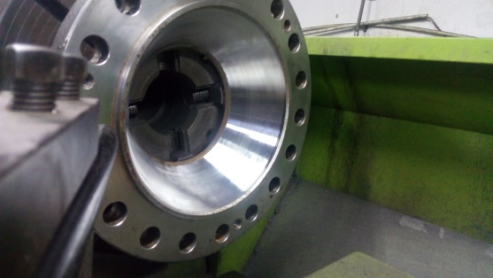
LIST OF EXPERIENCE
TNB REPAIR & MAINTENANCE SDN BHD

